Slide 1
Online Shoppers Intention Analysis

Slide 2
Introduction
Purpose
How can this help business
Topic
Source
Basic Information (columns)
Data
Logistic Regression
KNN
CART
Methods

Slide 3
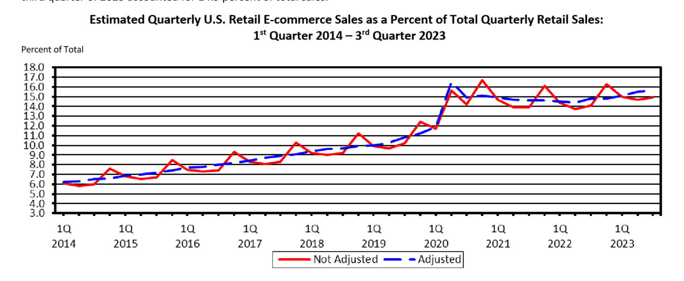
Topic - Importance
The estimate of U.S. retail e-commerce sales for Q3 of 2023 totaled $271.7 billion
15.6% of total Retail sales in the United States
US Department of Commerce. (2023). Ec current. https://www.census.gov/retail/mrts/www/data/pdf/ec_current.pdf

Slide 4
Data Introduction
Source:
UC Irvine Machine Learning Repository
Columns(18):
Administrative, Administrative_Duration, Informational, Information_Duration, ProductRelated, ProductRelated_Duration, BounceRates, ExitRates, PageValues, SpecialDay, Month, OperatingSystems, Browser, Region, TrafficType, VisitorType, Weekend
Revenue - representing whether or not the user completed the purchase.(bool)

Slide 5
Data Processing
1 | 2 | 3 | 4 | 5 | 6
Missing Values | Correlation Matrix | Drop Columns | Outliers | Dummy | Data Split

Slide 6
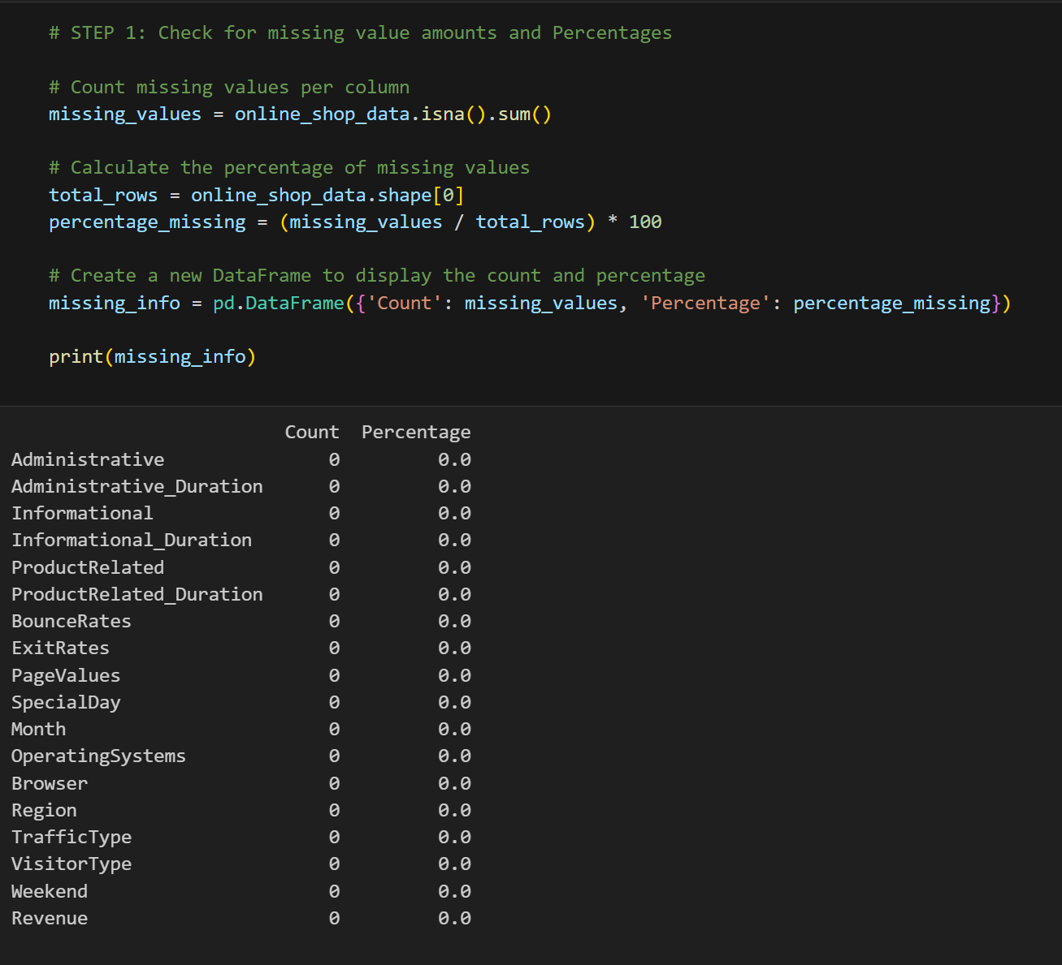
Data Processing - Clean
Assess amount of Missing values as a count and percent of total
No Missing records within the dataset

Slide 7
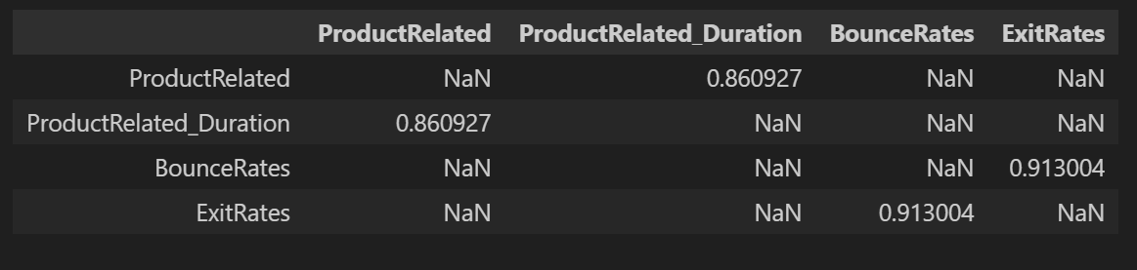
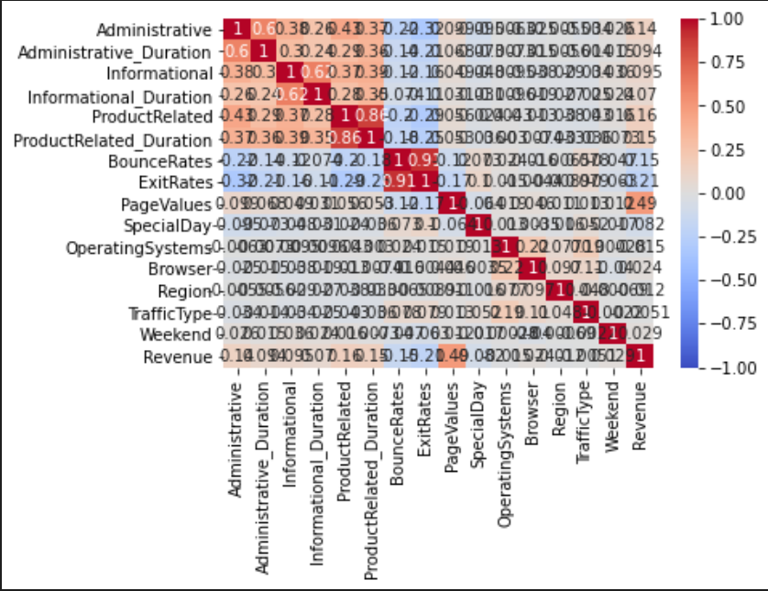
Data Processing - Correlation Matrix
Drop ProductRelated in favor of Duration, (Time spent on page)
"Bounce Rate" refers to the percentage of visitors who enter the site from that page and then leave ("bounce") without triggering any other requests to the analytics server.

Slide 8
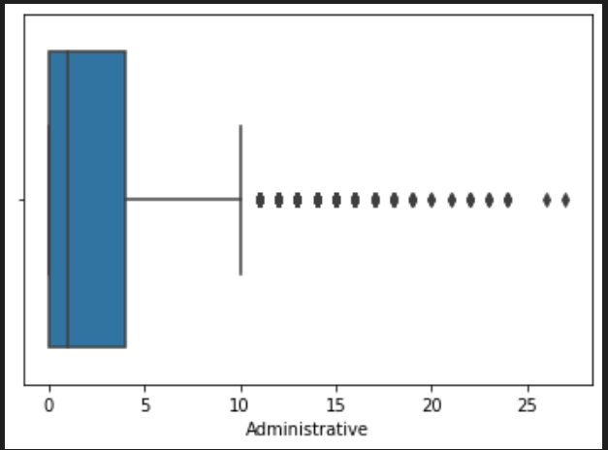
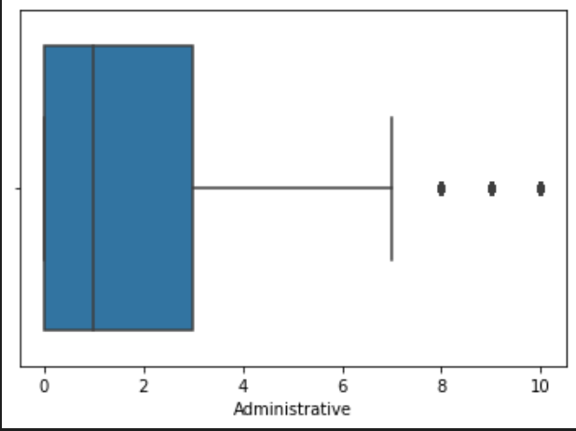
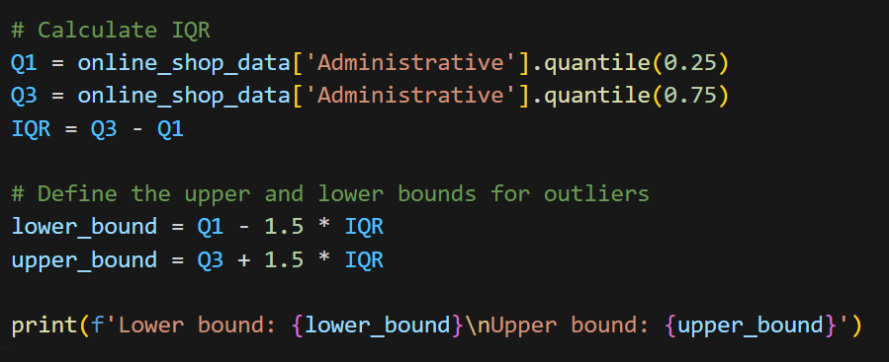
Data Processing - Outliers
Lower Bound = Q1 - IQR*1.5
Upper Bound = Q3 + IQR*1.5
Remove records outside bounds

Slide 9
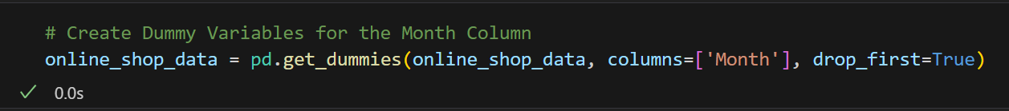
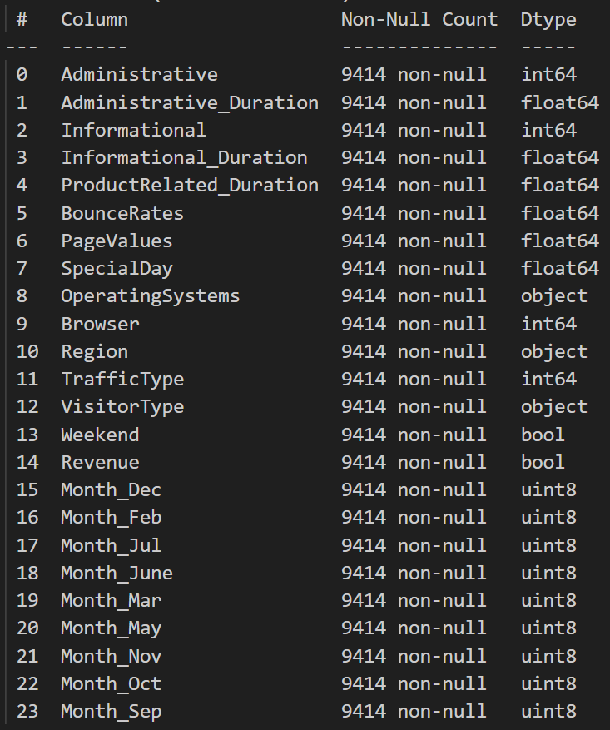
Data Processing - Dummy Variables
We created dummy variables for all appropriate variables
This provides a way to represent categorical information in a numerical format suitable for Logistic Regression, kNN, and CART.

Slide 10



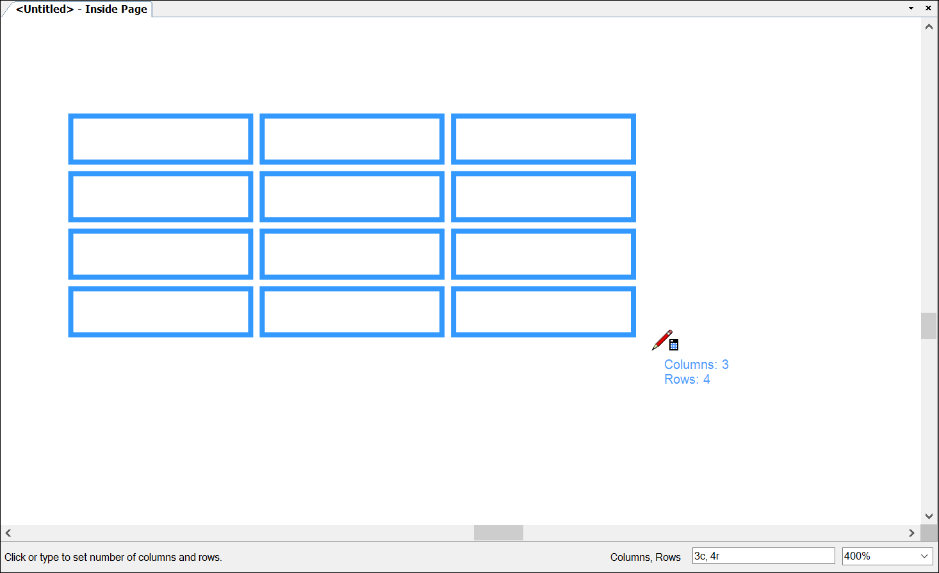
Logistic Regression
Logistic Regression
Analytics
Data Partitioning & Model Building
Test Set Evaluation
Exploring Cutoff Values

Slide 11
Logistic Regression
Initially, we randomly split the data into two sets. Training data consisting 75% of data from the cleaned dataset, and test data consisting the other 25% of the data.
We created two models using the GLM function, the Minimum model consisting of one variable and the Maximum model with all the variables.
Using the Step function, we implemented variable selection for all three directions, i.e., forward, backward, and both.
Dichotomize function was used to find out the misclassification error between the actual and predicted class. Later, sensitivity and specificity were obtained.

Slide 12
Three variable selection methods
Forward Selection- Starts with an empty set of predictor variables and iteratively adds the most significant variable at each step based on a predefined criterion (e.g., p-value, AIC, BIC).
Backward selection- Starts with a model containing all potential predictor variables and removes the least significant variable at each step until a stopping criterion is met.
Stepwise Selection:
Process: Combines elements of both forward selection and backward elimination. It starts with an empty set, adds or removes variables at each step, and continues until the addition or removal of variables no longer improves the model according to a specified criterion.

Slide 13
Logistic Regression
 |  | Forward | Backward | Stepwise
Cutoff=0.8 | Accuracy | 0.866 | 0.866 | 0.866
 | Specificity | 0.987 | 0.987 | 0.987
 | Validation Error | 0.133 | 0.133 | 0.133
 | Sensitivity | 0.291 | 0.295 | 0.291
Cutoff=0.5 | Accuracy | 0.882 | 0.882 | 0.882
 | Specificity | 0.978 | 0.977 | 0.978
 | Validation Error | 0.117 | 0.117 | 0.117
 | Sensitivity | 0.425 | 0.430 | 0.430
Cutoff=0.4 | Accuracy | 0.886 | 0.886 | 0.886
 | Specificity | 0.971 | 0.970 | 0.971
 | Validation Error | 0.113 | 0.113 | 0.113
 | Sensitivity | 0.479 | 0.486 | 0.479
Cutoff=0.3 | Accuracy | 0.886 | 0.882 | 0.886
 | Specificity | 0.962 | 0.954 | 0.962
 | Validation Error | 0.113 | 0.117 | 0.113
 | Sensitivity | 0.522 | 0.543 | 0.522
Trend: We can see, as we increase the cutoff, sensitivity decreases, and specificity increases.

Slide 14
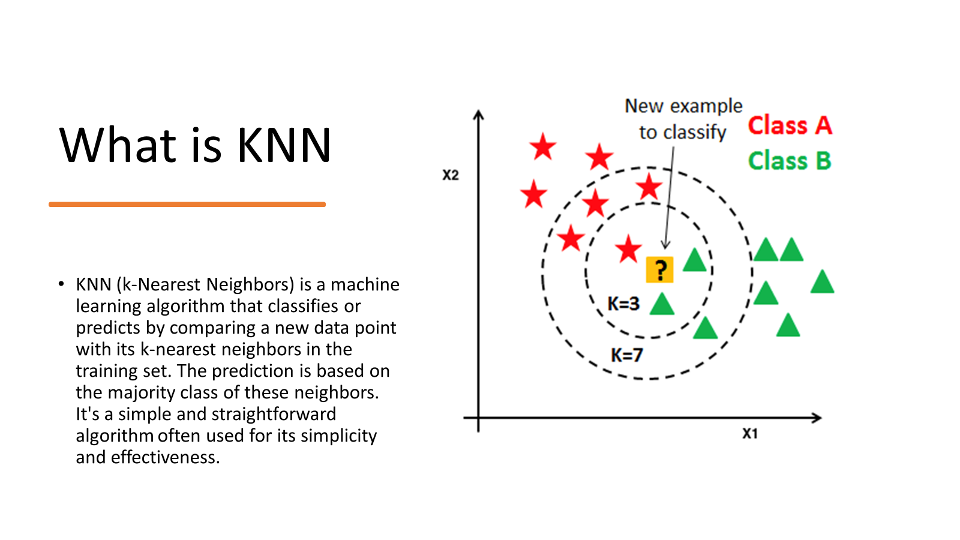

Slide 15
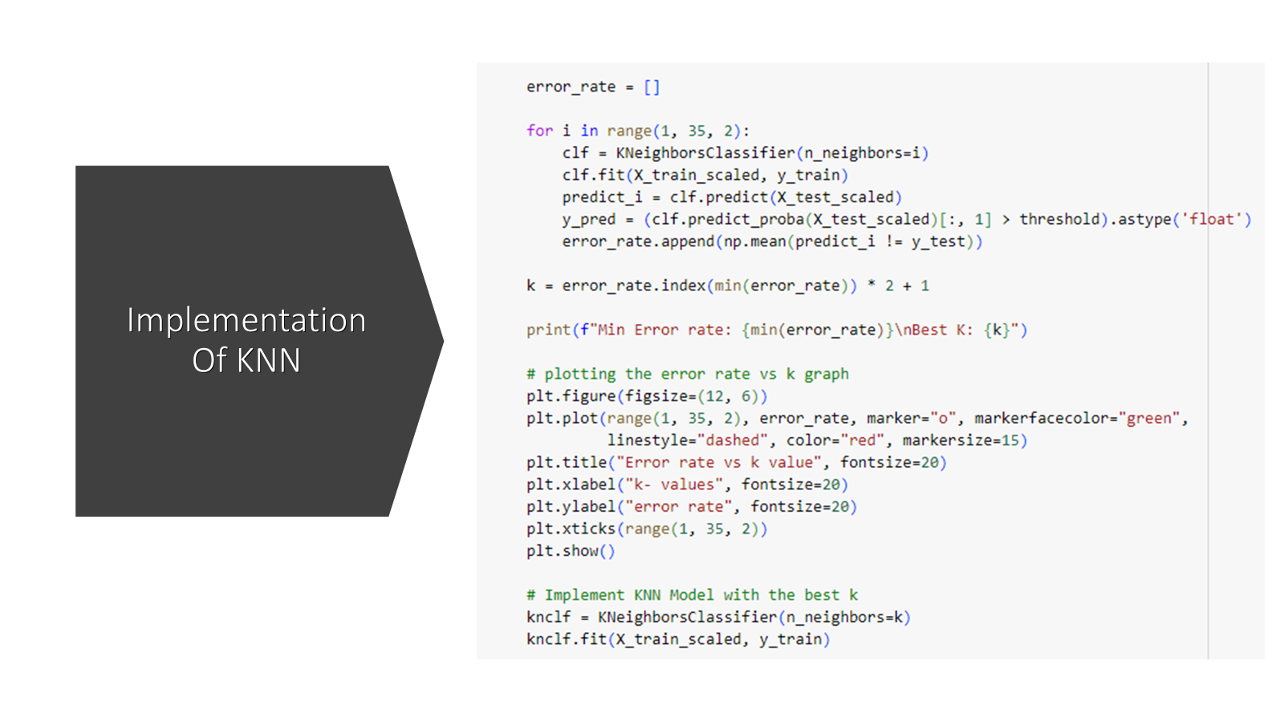

Slide 16
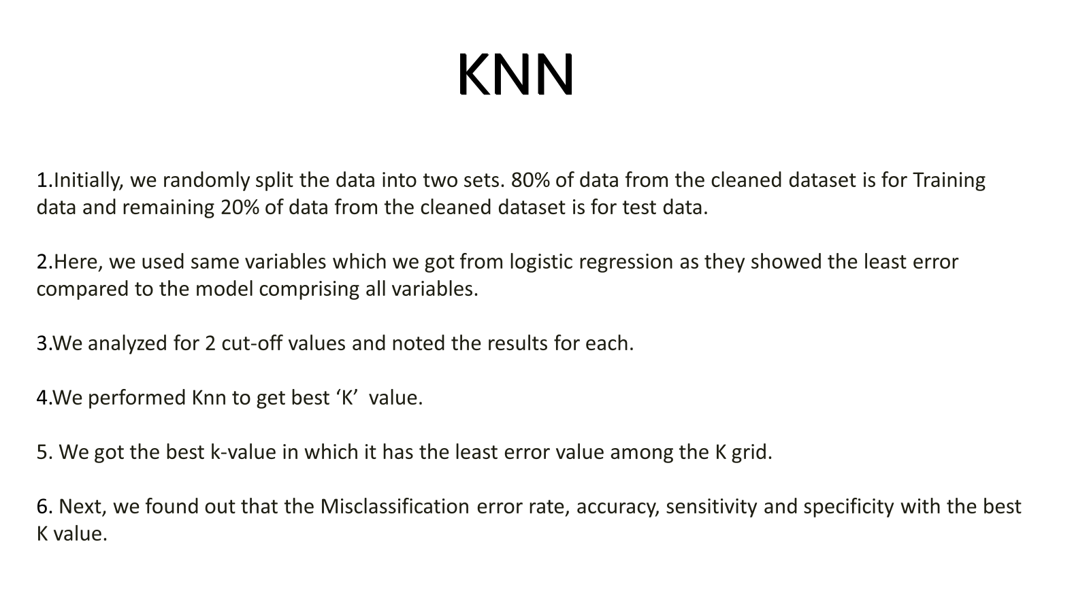

Slide 17
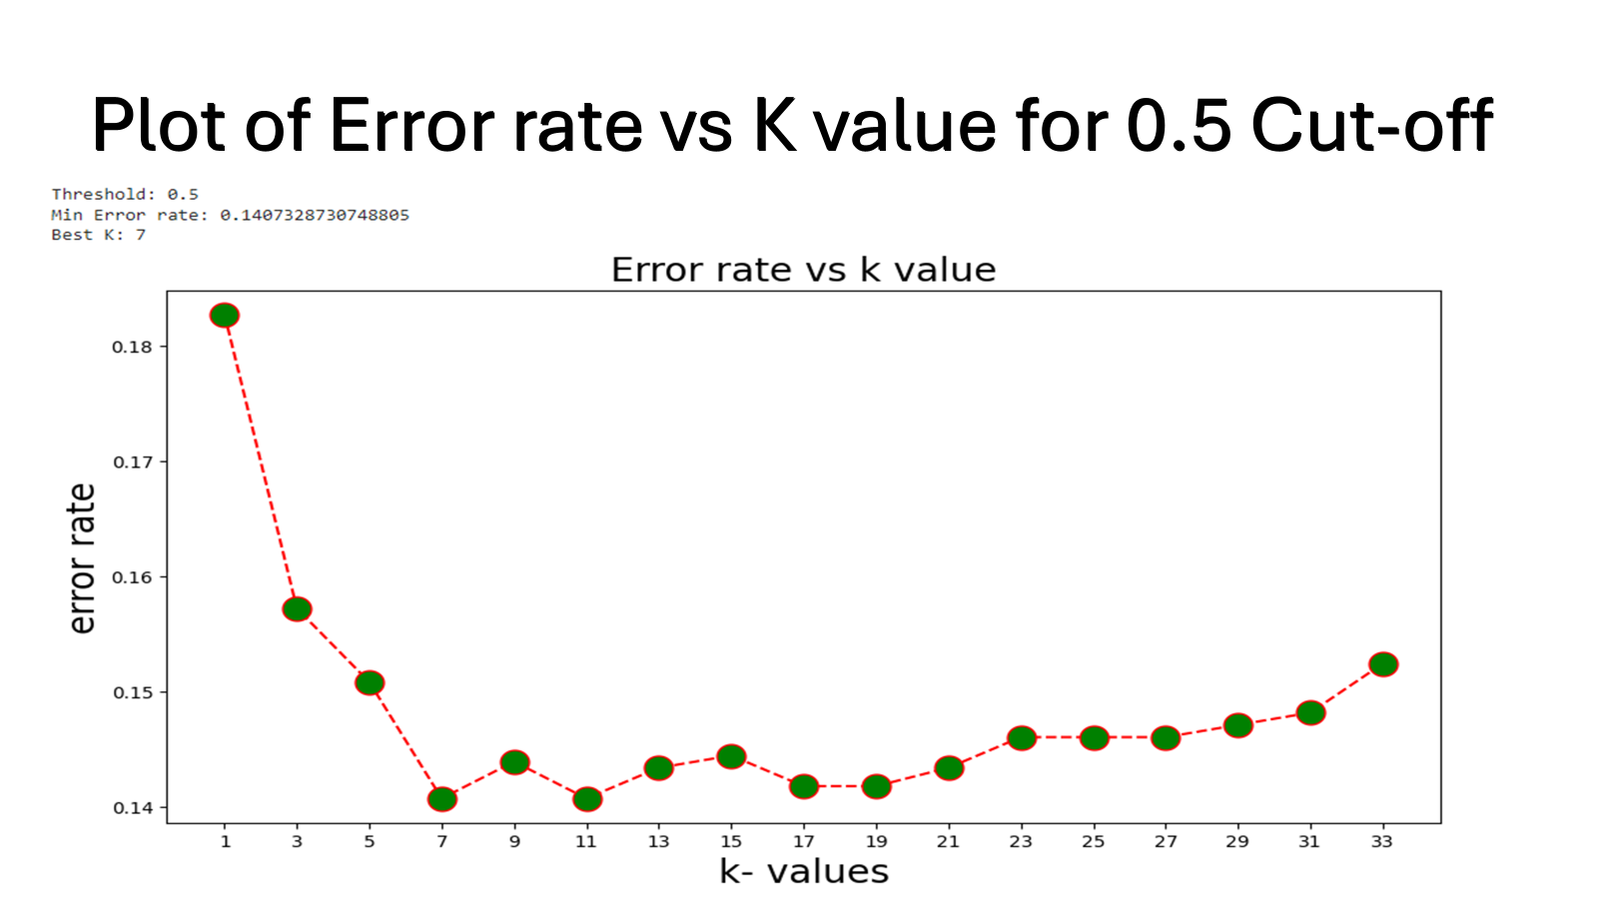

Slide 18
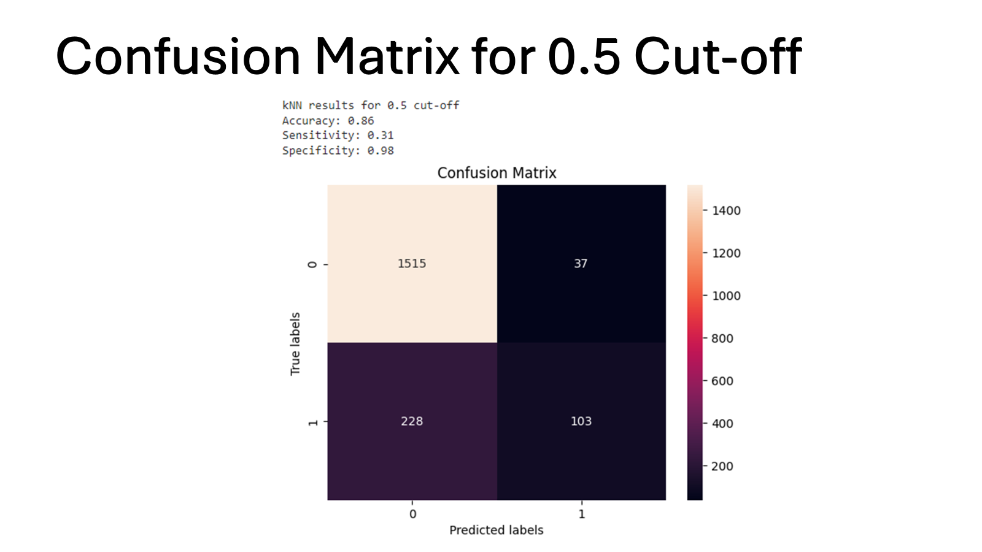

Slide 19
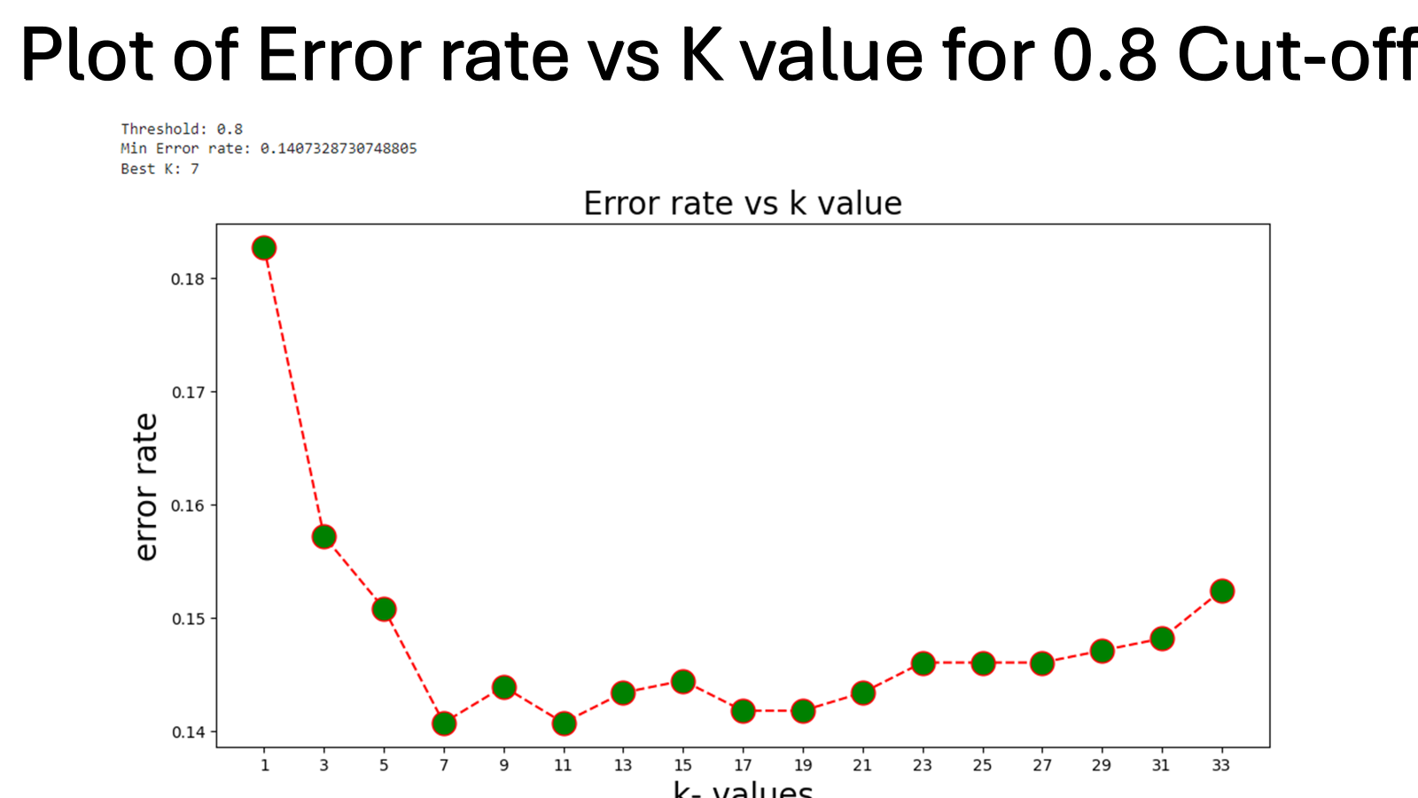

Slide 20
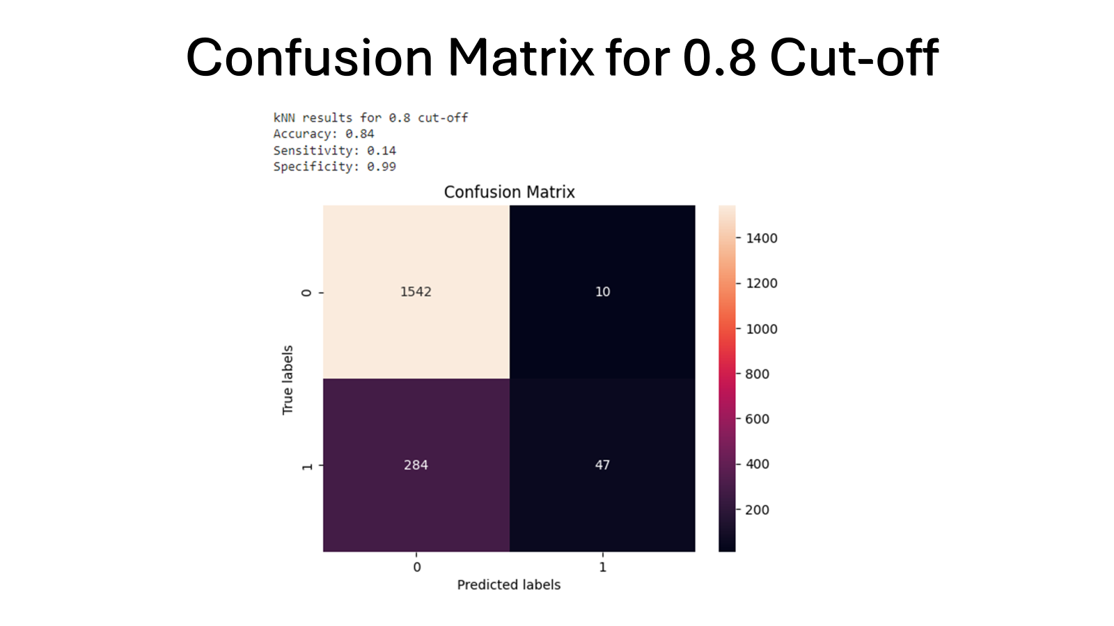

Slide 21
KNN
A similar trend to logistic regression is observed; sensitivity decreases, and specificity increases as we increase the cutoff.
 |  | K=7
Cutoff= 0.8 | Accuracy | 0.84
 | Sensitivity: | 0.14
 | Specificity: | 0.99
Cutoff=0.5 | Accuracy | 0.86
 | Sensitivity | 0.31
 | Specificity | 0.98
Cutoff=0.4 | Accuracy | 0.85
 | Sensitivity | 0.42
 | Specificity | 0.94
Cutoff=0.3 | Accuracy | 0.85
 | Sensitivity | 0.42
 | Specificity | 0.94

Slide 22

CART - Classification Tree
Used RPlot, Random Forest, and ADAbag library in R to build our classification decision tree.
First we built a full tree and pruned it using:
Minimum error tree
Best pruned tree
Random Forest
Used 50% Cutoff and 80% Cutoff

Slide 23
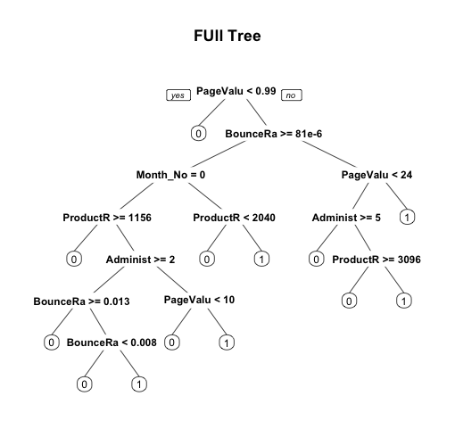

Full Tree
CP nsplit rel error xerror xstd
1 0.247515808 0 1.0000000 1.0000000 0.02759890
2 0.085817525 1 0.7524842 0.7579042 0.02456185
3 0.043360434 2 0.6666667 0.7253839 0.02409855
4 0.014453478 3 0.6233062 0.6612466 0.02313869
5 0.013550136 5 0.5943993 0.6549232 0.02304052
6 0.006323397 7 0.5672990 0.6278229 0.02261214
7 0.005420054 10 0.5483288 0.6169828 0.02243720
8 0.005000000 12 0.5374887 0.6187895 0.02246650
Notes:
If you have a class imbalance, you might want to know if your model's accuracy is better than the proportion of the data with the majority class. So if you have two classes and 70% of your data are class #1, is an accuracy of 75% any better than the "non-information rate" of 70%.

Slide 24
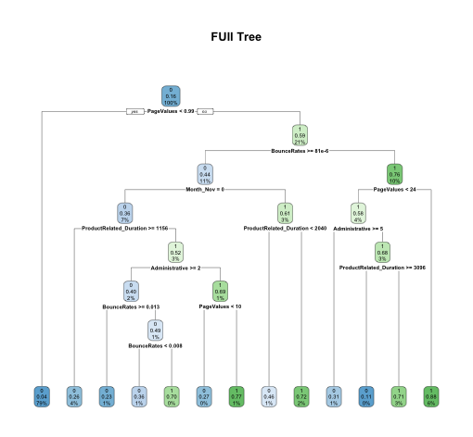
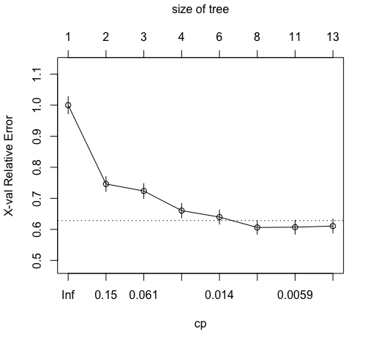
Full Tree

Slide 25
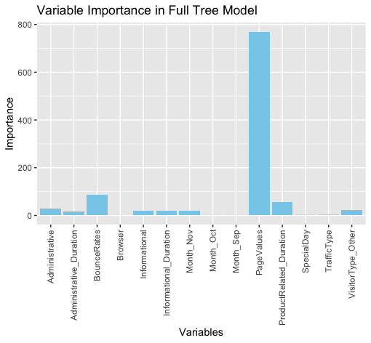
fit$variable.importance
PageValues BounceRates ProductRelated_Duration Administrative VisitorType_Other
769.8658529 88.0927741 57.4956506 29.2176576 22.6595614
Informational Informational_Duration Month_Nov Administrative_Duration TrafficType
21.0217932 18.9623447 18.7127256 16.4500945 1.8609152
SpecialDay Month_Sep Month_Oct Browser
1.2154540 0.5072808 0.3922377 0.2890000

Slide 26

Full Tree Accuracy
Confusion Matrix and Statistics
Reference
Prediction 0 1
0 1860 191
1 67 236
Accuracy : 0.8904
95% CI : (0.8771, 0.9027)
No Information Rate : 0.8186
P-Value [Acc > NIR] : < 2.2e-16
Kappa : 0.5839
Mcnemar's Test P-Value : 1.894e-14
Sensitivity : 0.9652
Specificity : 0.5527
Pos Pred Value : 0.9069
Neg Pred Value : 0.7789
Prevalence : 0.8186
Detection Rate : 0.7901
Detection Prevalence : 0.8713
Balanced Accuracy : 0.7590
'Positive' Class : 0

Slide 27
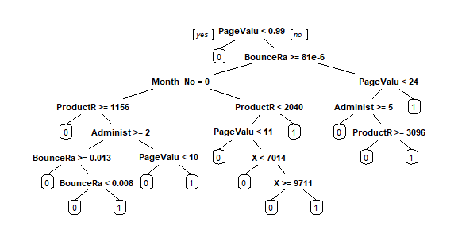

Minimum Error Tree
CP nsplit rel error xerror xstd
1 0.247515808 0 1.0000000 1.0000000 0.02759890
2 0.085817525 1 0.7524842 0.7579042 0.02456185
3 0.043360434 2 0.6666667 0.7253839 0.02409855
4 0.014453478 3 0.6233062 0.6612466 0.02313869
5 0.013550136 5 0.5943993 0.6549232 0.02304052
6 0.006323397 7 0.5672990 0.6278229 0.02261214
7 0.005420054 10 0.5483288 0.6169828 0.02243720

Slide 28
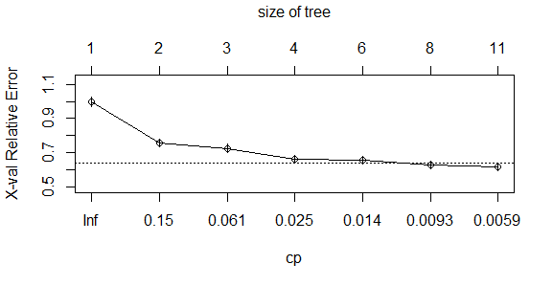
Minimum Error Tree
PageValues BounceRates ProductRelated_Duration Administrative
761.3397260 77.4081729 43.6471683 27.2763304
VisitorType_Other Informational Month_Nov Informational_Duration
22.6595614 21.0217932 18.7127256 18.7087043
Administrative_Duration X SpecialDay Month_Oct
15.8469636 8.5908422 0.9264540 0.3922377

Slide 29
Min Error Tree
50% Probability Cutoff 80% Probability Cutoff
Confusion Matrix and Statistics
Reference
Prediction 0 1
0 1864 195
1 63 232
Accuracy : 0.8904
95% CI : (0.8771, 0.9027)
No Information Rate : 0.8186
P-Value [Acc > NIR] : < 2.2e-16
Kappa : 0.5805
Mcnemar's Test P-Value : 3.472e-16
Sensitivity : 0.9673
Specificity : 0.5433
Pos Pred Value : 0.9053
Neg Pred Value : 0.7864
Prevalence : 0.8186
Confusion Matrix and Statistics
Reference
Prediction 0 1
0 1906 304
1 21 123
Accuracy : 0.8619
95% CI : (0.8473, 0.8756)
No Information Rate : 0.8186
P-Value [Acc > NIR] : 1.002e-08
Kappa : 0.3735
Mcnemar's Test P-Value : < 2.2e-16
Sensitivity : 0.9891
Specificity : 0.2881
Pos Pred Value : 0.8624
Neg Pred Value : 0.8542
Prevalence : 0.8186

Slide 30
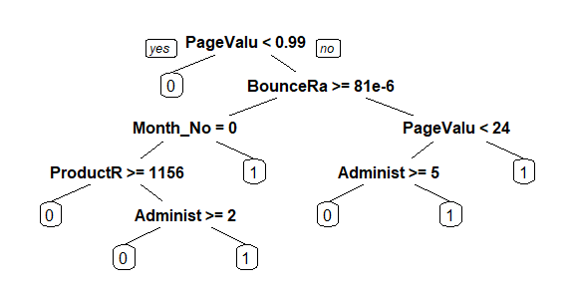

Best Pruned tree using
CP nsplit rel error xerror xstd
1 0.247515808 0 1.0000000 1.0000000 0.02759890
2 0.085817525 1 0.7524842 0.7579042 0.02456185
3 0.043360434 2 0.6666667 0.7253839 0.02409855
4 0.014453478 3 0.6233062 0.6612466 0.02313869
5 0.013550136 5 0.5943993 0.6549232 0.02304052
6 0.006323397 7 0.5672990 0.6278229 0.02261214

Slide 31
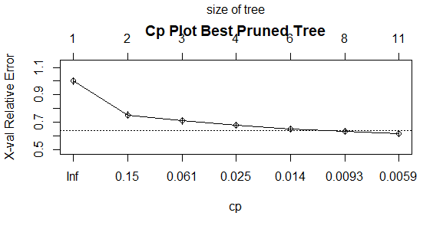
Best Pruned tree Variable Importance and Number of Splits
fit$variable.importance
PageValues BounceRates ProductRelated_Duration Administrative
769.8658529 88.0927741 57.4956506 29.2176576
VisitorType_Other Informational Informational_Duration Month_Nov
22.6595614 21.0217932 18.9623447 18.7127256
Administrative_Duration TrafficType SpecialDay Month_Sep
16.4500945 1.8609152 1.2154540 0.5072808
Month_Oct Browser
0.3922377 0.2890000

Slide 32
50% Probability Cutoff 80% Probability Cutoff
Confusion Matrix and Statistics
Reference
Prediction 0 1
0 1906 304
1 21 123
Accuracy : 0.8619
95% CI : (0.8473, 0.8756)
No Information Rate : 0.8186
P-Value [Acc > NIR] : 1.002e-08
Kappa : 0.3735
Mcnemar's Test P-Value : < 2.2e-16
Sensitivity : 0.9891
Specificity : 0.2881
Pos Pred Value : 0.8624
Neg Pred Value : 0.8542
Prevalence : 0.8186
Detection Rate : 0.8097
Detection Prevalence : 0.9388
Balanced Accuracy : 0.6386
'Positive' Class : 0
Confusion Matrix and Statistics
Reference
Prediction 0 1
0 1844 155
1 83 272
Accuracy : 0.8989
95% CI : (0.886, 0.9108)
No Information Rate : 0.8186
P-Value [Acc > NIR] : < 2.2e-16
Kappa : 0.6356
Mcnemar's Test P-Value : 4.18e-06
Sensitivity : 0.9569
Specificity : 0.6370
Pos Pred Value : 0.9225
Neg Pred Value : 0.7662
Prevalence : 0.8186
Detection Rate : 0.7833
Detection Prevalence : 0.8492
Balanced Accuracy : 0.7970
'Positive' Class : 0

Slide 33

Random Forest Ensemble Tree
Steps:
Load randomForest package
Create model
n-tree = 500
mtry = 4
nodesize = 5
Predict with test dataset
Compare the predicted values with actual values
Test with 50% and 80% cutoff.
Confusion Matrix and Statistics
Reference
Prediction 0 1
0 1870 205
1 57 222
Accuracy : 0.8887
95% CI : (0.8753, 0.9011)
No Information Rate : 0.8186
P-Value [Acc > NIR] : < 2.2e-16
Kappa : 0.5668
Mcnemar's Test P-Value : < 2.2e-16
Sensitivity : 0.9704
Specificity : 0.5199
Pos Pred Value : 0.9012
Neg Pred Value : 0.7957
Prevalence : 0.8186
Detection Rate : 0.7944
Detection Prevalence : 0.8815
Balanced Accuracy : 0.7452
'Positive' Class : 0

Slide 34

Random Forest Ensemble Tree
50% Cutoff
Confusion Matrix and Statistics
Reference
Prediction 0 1
0 1872 201
1 55 226
Accuracy : 0.8912
95% CI : (0.878, 0.9035)
No Information Rate : 0.8186
P-Value [Acc > NIR] : < 2.2e-16
Kappa : 0.5776
Mcnemar's Test P-Value : < 2.2e-16
Sensitivity : 0.9715
Specificity : 0.5293
Pos Pred Value : 0.9030
Neg Pred Value : 0.8043
Prevalence : 0.8186
Detection Rate : 0.7952
Detection Prevalence : 0.8806
Balanced Accuracy : 0.7504
'Positive' Class : 0
80% Cutoff
Confusion Matrix and Statistics
Reference
Prediction 0 1
0 1924 358
1 3 69
Accuracy : 0.8466
95% CI : (0.8314, 0.861)
No Information Rate : 0.8186
P-Value [Acc > NIR] : 0.0001767
Kappa : 0.2366
Mcnemar's Test P-Value : < 2.2e-16
Sensitivity : 0.9984
Specificity : 0.1616
Pos Pred Value : 0.8431
Neg Pred Value : 0.9583
Prevalence : 0.8186
Detection Rate : 0.8173
Detection Prevalence : 0.9694
Balanced Accuracy : 0.5800

Slide 35

Boosted tree Confusion Matrix
Confusion Matrix and Statistics
Reference
Prediction 0 1
0 1851 178
1 76 249
Accuracy : 0.8921
95% CI : (0.8789, 0.9044)
No Information Rate : 0.8186
P-Value [Acc > NIR] : < 2.2e-16
Kappa : 0.5994
Mcnemar's Test P-Value : 2.338e-10
Sensitivity : 0.9606
Specificity : 0.5831
Pos Pred Value : 0.9123
Neg Pred Value : 0.7662
Prevalence : 0.8186
Detection Rate : 0.7863
Detection Prevalence : 0.8619
Balanced Accuracy : 0.7718
'Positive' Class : 0
Steps:
Load packages needed
adabag, caret, rpart
Prepare data
Use as.factor() to make sure all factors are categorical.
Build the boosted tree model
Make and store predicted values.
Evaluate model performance.
confusionMatrix()
Test variables’ importance

Slide 36
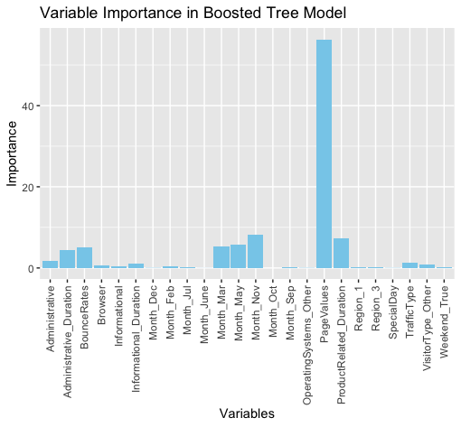

Boosted Tree$importance

Slide 37
Summary
 | Results
 |  | Logistic Regression |  |  |  | kNN k=7 |  | Classification Tree
 |  | Forward | Backward | Stepwise |  |  |  | Minimum Error | Best Pruned | Random Forest
Cutoff=0.5 | Val ER | 0.425 | 0.430 | 0.430 |  | 0.163 |  | 0.109 | 0.101 | 0.109
 | Sensitivity | 0.117 | 0.117 | 0.117 |  | 0.232 |  | 0.967 | 0.957 | 0.972
 | Specificity | 0.978 | 0.977 | 0.978 |  | 0.965 |  | 0.543 | 0.637 | 0.529
Cutoff=0.8 | Val ER | 0.291 | 0.295 | 0.291 |  | 0.160 |  | 0.138 | 0.138 | 0.153
 | Sensitivity | 0.987 | 0.987 | 0.987 |  | 0.140 |  | 0.989 | 0.989 | 0.998
 | Specificity | 0.133 | 0.133 | 0.133 |  | 0.990 |  | 0.288 | 0.288 | 0.161
Notes:
In summary, if we take a look at 50% cutoff, we can see that the best pruned tree is the best model with the smallest validation error rate, followed by the minimum error tree and the random forest.
On the other hand for 80% cutoff, the best pruned tree and the minimum error have the smallest validation error rate, followed by the random forest.
Therefore, we can conclude that the models from the classification tree perform better than models from logistic regression and KNN.

Slide 38
Conclusion
Inference drawn from our daily life experience could be inaccurate.
Ex: “SpecialDay” and “Weekend” variables have no significant impact on customers buying behavior.
As we compared with prior research, we found out that:
User Experience Matters: factors such as website design, navigation, and loading speed play crucial roles.
Social Influence: positive reviews and social endorsements can influence purchasing decisions.
Application in real-world situations:
Allocate more advertising budget on months when customers are more likely to make a purchase.
Redesign the user interface for the informational page to provide better experience.
Notes:
In conclusion, the lesson that we learned from the analysis is that our inference drawn from our daily life experience could be inaccurate.
For example, we often believe that special day such as Valentine’s day or during the weekends can influence the purchasing power, but actually these two variables have no significant impact on customers buying behavior. We can support this statement by the result from our Random Forest analysis and one reason that we can think of is that maybe customers usually make most of their quick purchases during random time in order to fulfill the daily needs such as making a quick purchase of household supplies.
And as we compared with prior research, we found out that the variables impacting the customer buying behavior are different. The past research found out that positive user experience on websites and applications can significantly impact the buying behavior. And factors such as website design, navigation, and loading speed play crucial roles.
Moreover, social media and peer recommendations often play a role in shaping customers buying behavior and this includes positive reviews and social endorsements.
And finally, we can apply the result from our analysis to the real-world situations such as we can allocate more advertising budget on months when customers are more likely to make a purchase, for example, in May or November.
Also, we can redesign the user interface for the informational page to provide better experience so that customers can browse the page longer which might lead to a purchase.

Slide 39
Limitations and Future Research
Limitations:
Sample Bias: may introduce selection bias, as individuals who chose to participate might have different characteristics than those who did not.
External Events: changes in market trends or unexpected global events such as the pandemic.
Future Research:
Should consider the geographical variable “Region” because shopping behaviors may change in different places.
Should consider the “TrafficType” to see the source in which the customers arrive at the website so that businesses can choose the best way of advertising.
Notes:
Now, let’s move on to the limitations and future research.
First, the limitations of our analysis are that the study relied on a sample of online shoppers who voluntarily participated in the survey and this may introduce selection bias because individuals who chose to participate might have different characteristics than those who did not.
Another limitation is external events. Changes in market trends or unexpected global events such as the Covid-19 pandemic significantly changed the customer buying behavior so our results might not represent the current situation.
Therefore, in the future research, we should consider the geographical variable “Region” because shopping behaviors may change in different places.
And, we should also consider the “TrafficType” to see the source in which the customers arrive at the website so that businesses can choose the best way of advertising.

Slide 40


